Slide 1

Crash Statistics
Reviewing Crash Data for Western Australia
CITS5504 | Data Warehousing
David Smith (21484971)
Notes:
David:
IoT Pet Pal with a focus on pet safety, owner peace of mind, and increasing the quality of life

Slide 2
Storing Crash Related Data for Analysis and Intervention Evaluation.
Notes:
David:
Pets are not just animals but loved members of the family, our solution builds on our passions for our animals and looks to provide a care solution

Slide 3
Business Questions
Defining Key Questions to Drive Data Warehouse Design
CITS5504 | Data Warehousing | David Smith | 21484971
Notes:
David:
IoT Pet Pal with a focus on pet safety, owner peace of mind, and increasing the quality of life

Slide 4
Datasets | Crash Data (Last Five Years)
5 Key Questions:
What are the worst roads for serious crashes?
What Local Government Regions have the highest number of fatal crashes?
What proportion of crashes occur during peak hour?
Are there more motorcycle crashes on rainy day than dry days?
What Regions have the most crashes?
CITS5504 | Data Warehousing | David Smith | 21484971
Notes:
David:
Our methodology was to first define the problem
We would then propose a solution to the problem and build a prototype
Collect data
Then analyze the intervention
Iterate

Slide 5
ETL & Warehouse Process
Defining the Data Warehouse Process
CITS5504 | Data Warehousing | David Smith | 21484971
Notes:
David:
IoT Pet Pal with a focus on pet safety, owner peace of mind, and increasing the quality of life

Slide 6
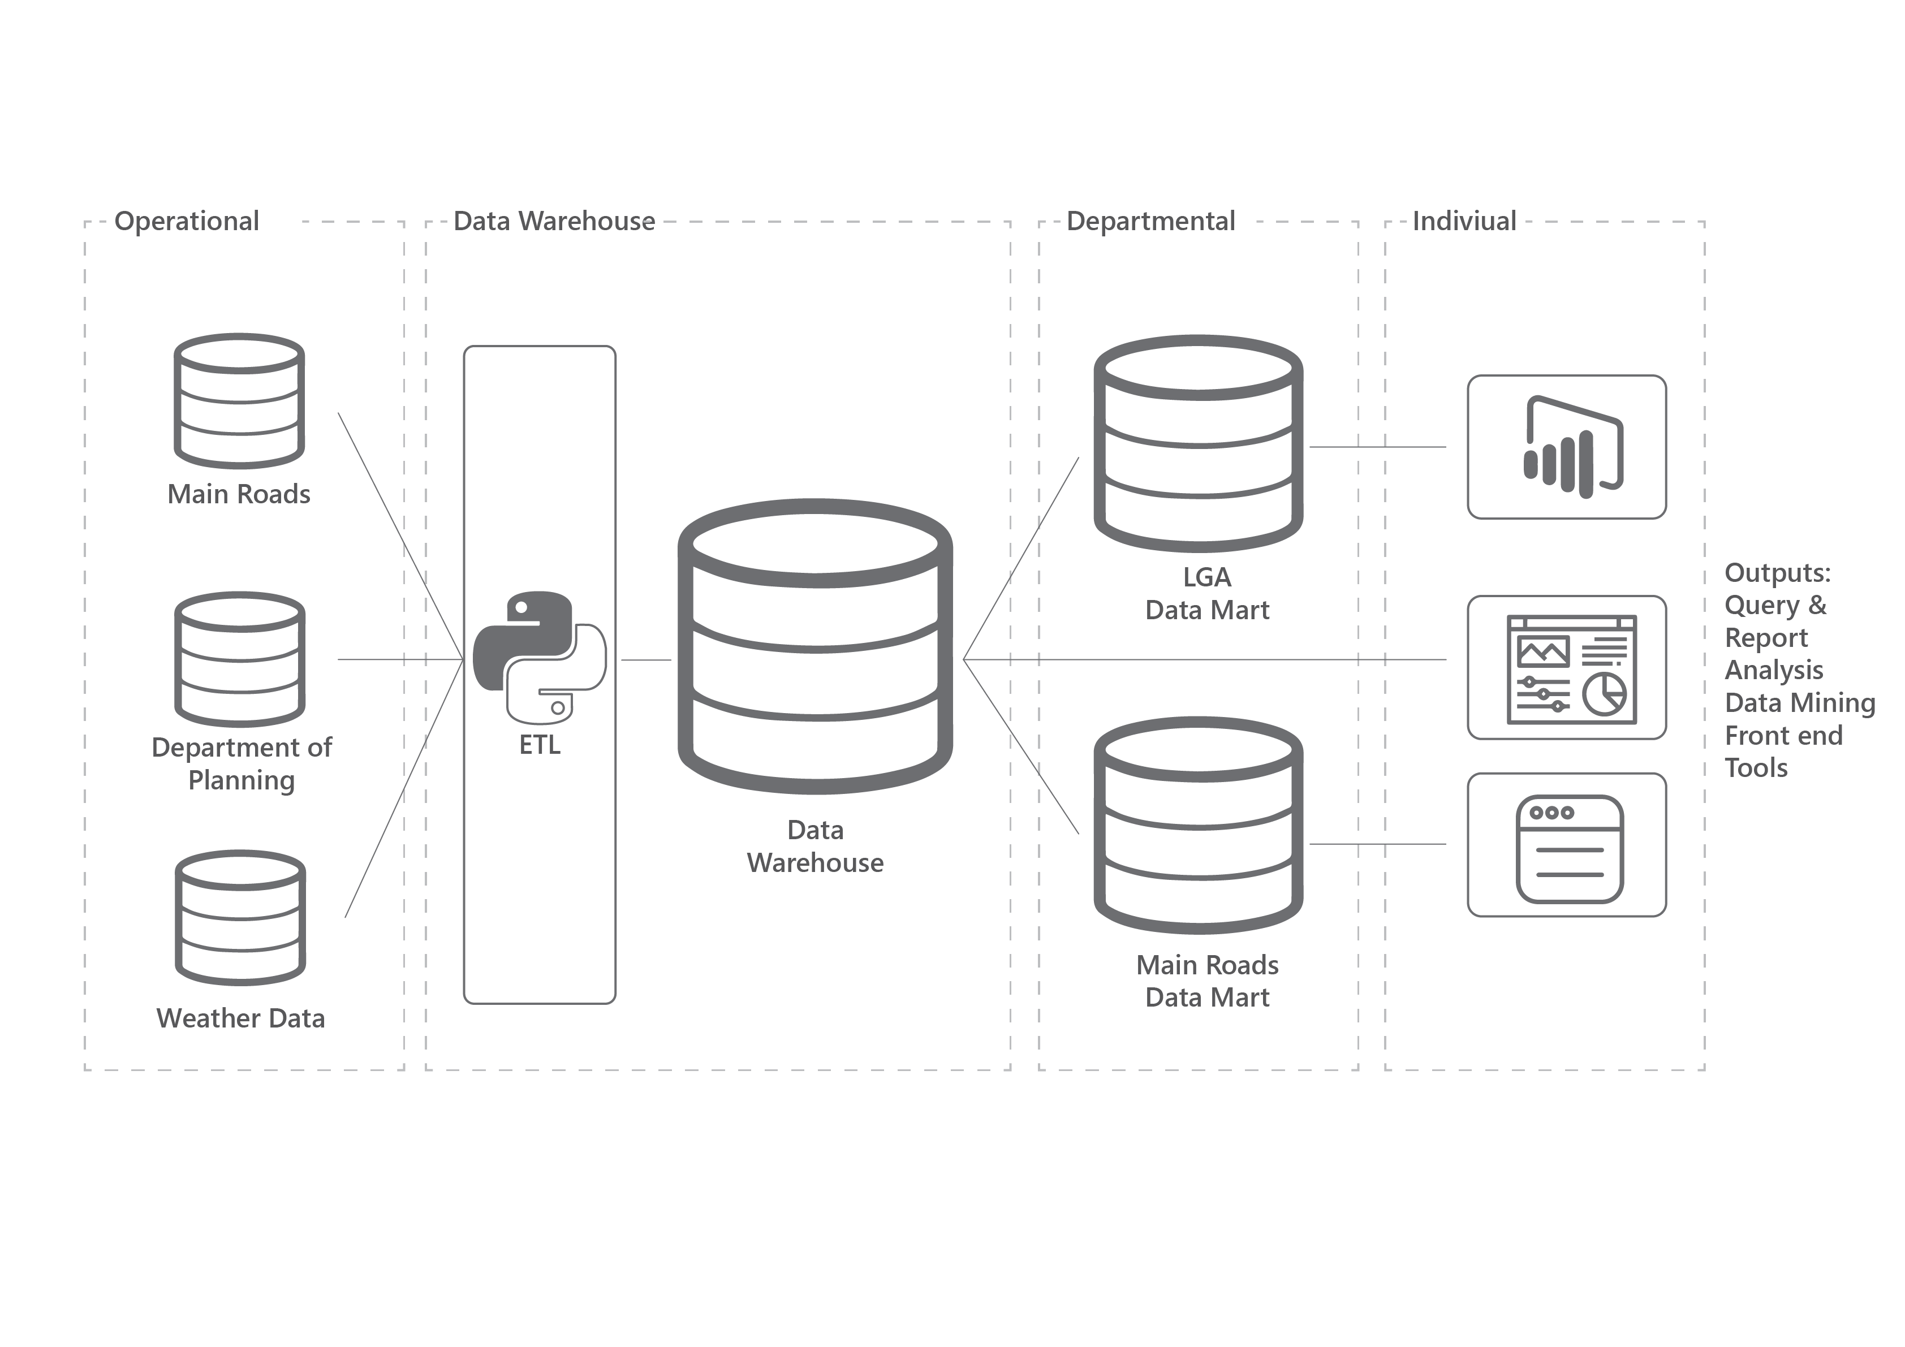
Data Warehouse | Process
CITS5504 | Data Warehousing | David Smith | 21484971
Notes:
David:
Our methodology was to first define the problem
We would then propose a solution to the problem and build a prototype
Collect data
Then analyze the intervention
Iterate

Slide 7
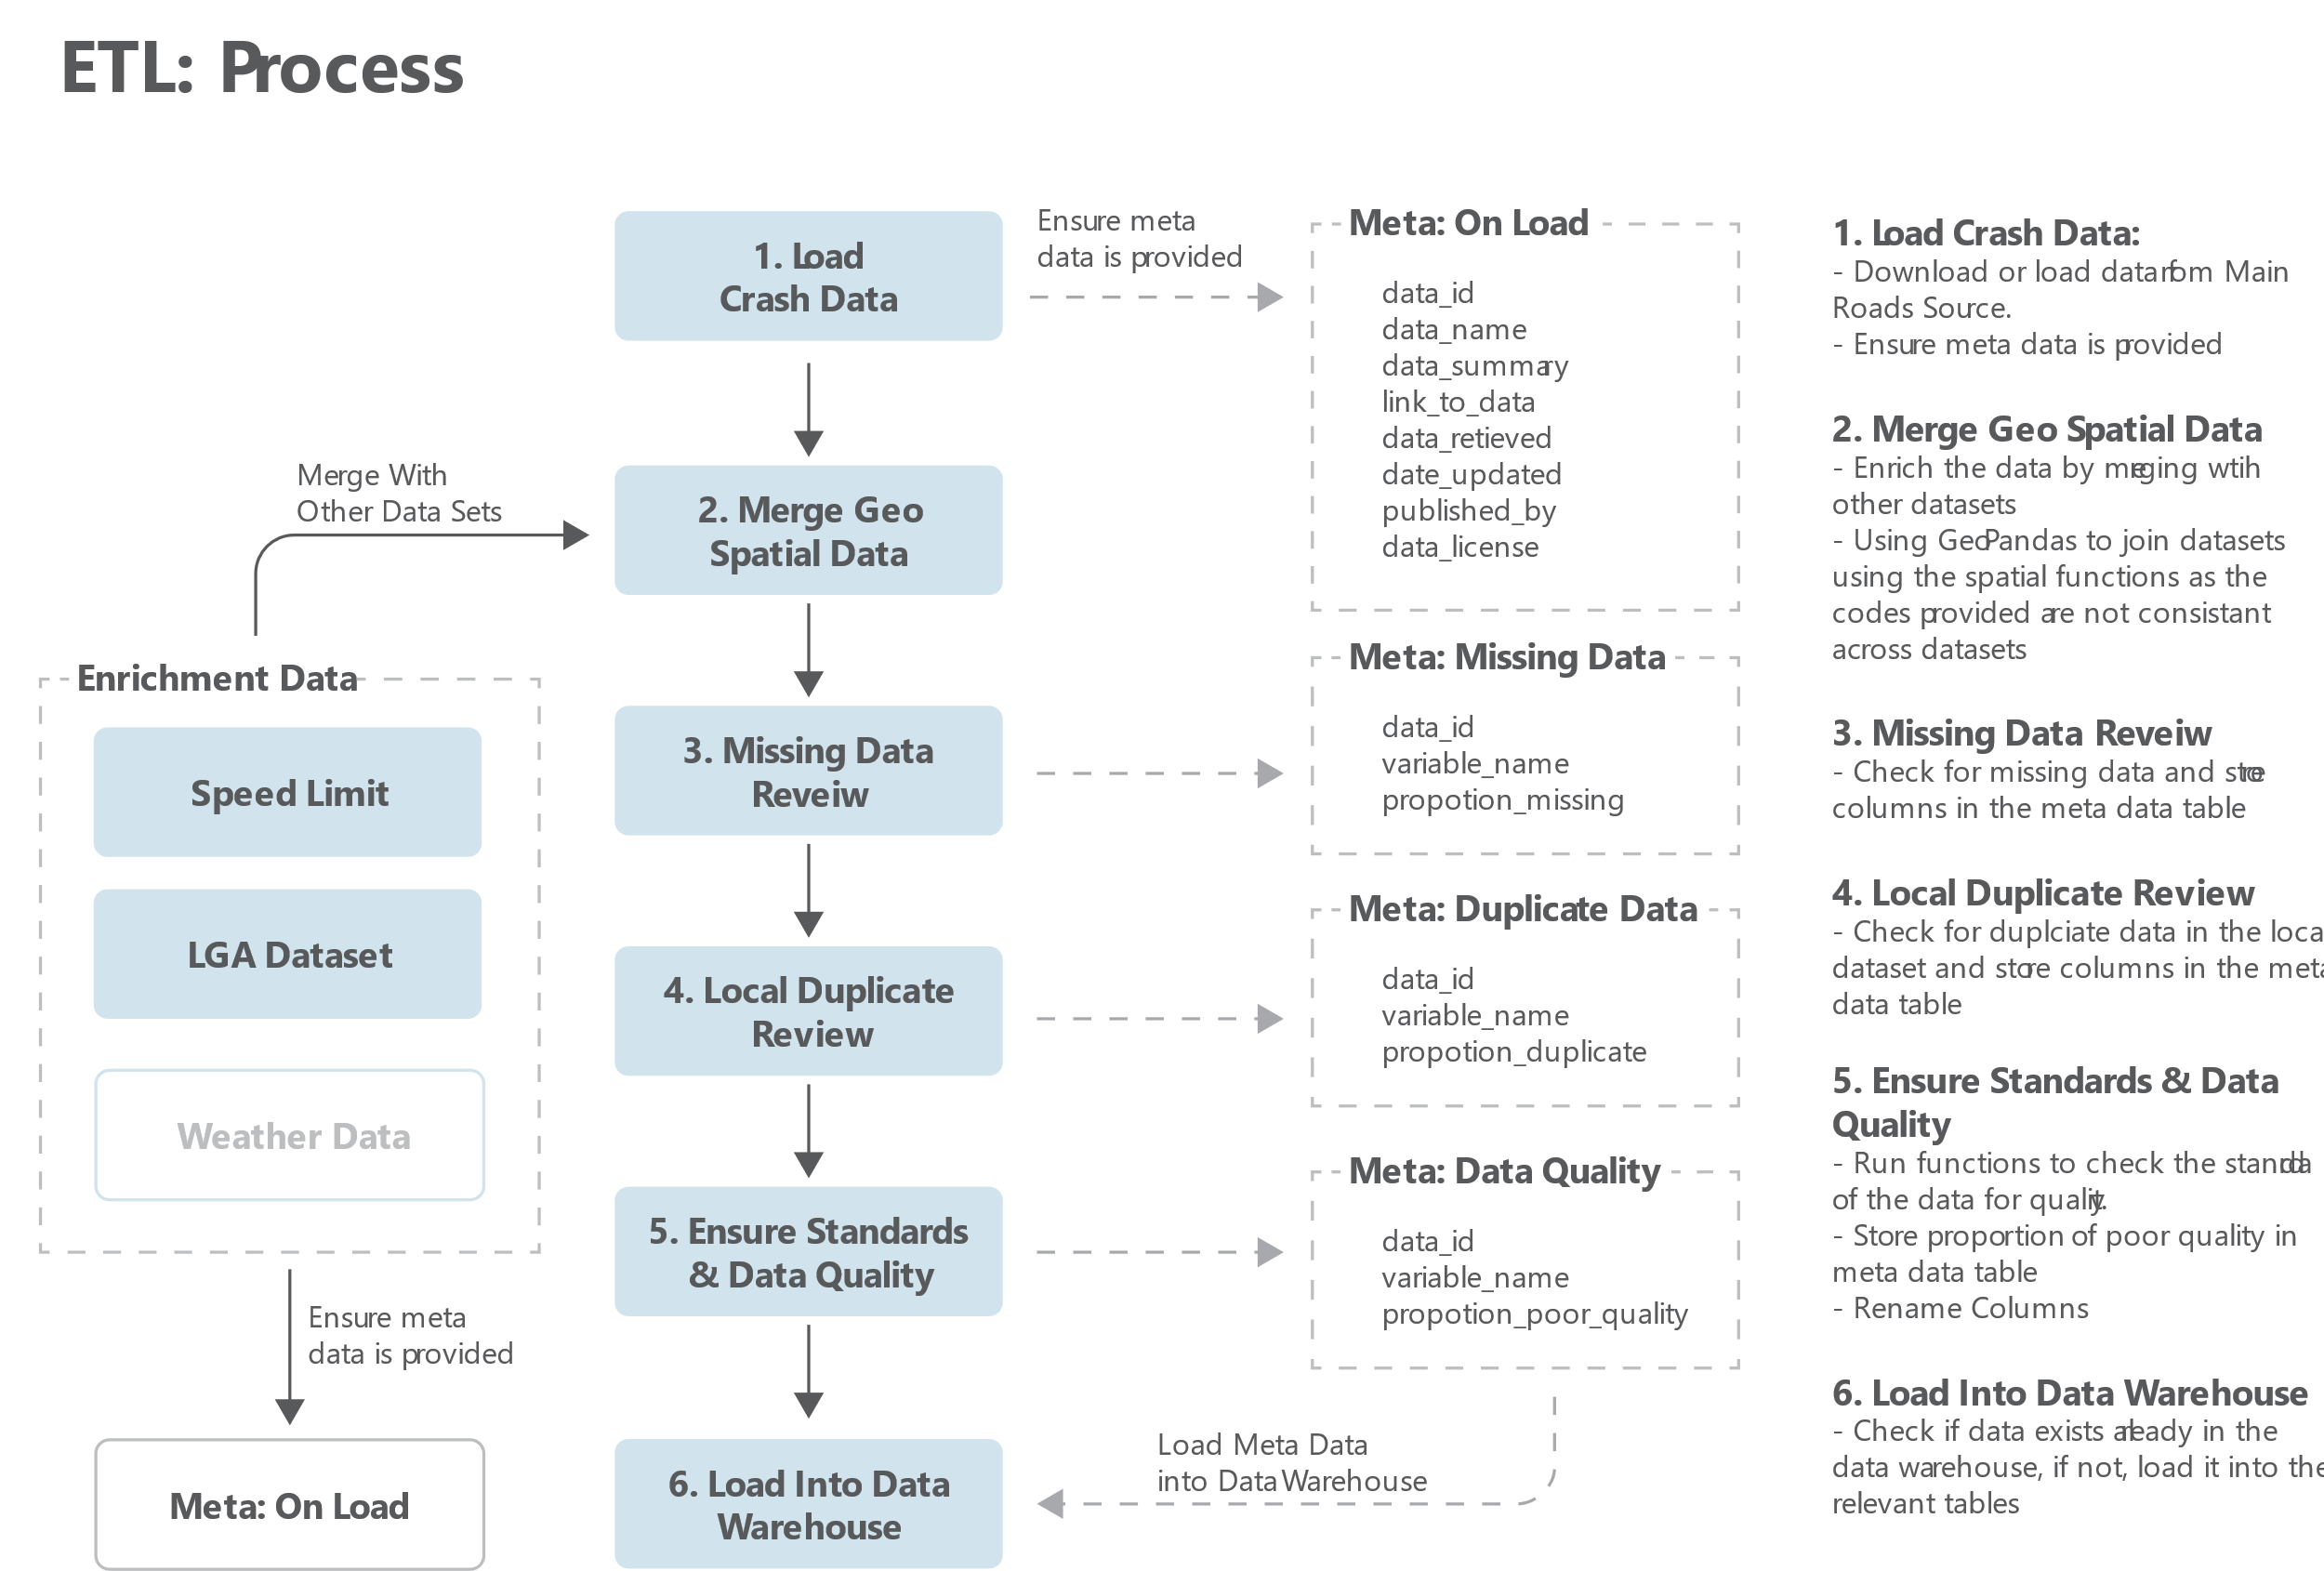
Methodology | Process of Development
CITS5504 | Data Warehousing | David Smith | 21484971
Notes:
David:
Our methodology was to first define the problem
We would then propose a solution to the problem and build a prototype
Collect data
Then analyze the intervention
Iterate

Slide 8
StarNet
Mapping Data Dimensions
CITS5504 | Data Warehousing | David Smith | 21484971
Notes:
David:
IoT Pet Pal with a focus on pet safety, owner peace of mind, and increasing the quality of life

Slide 9
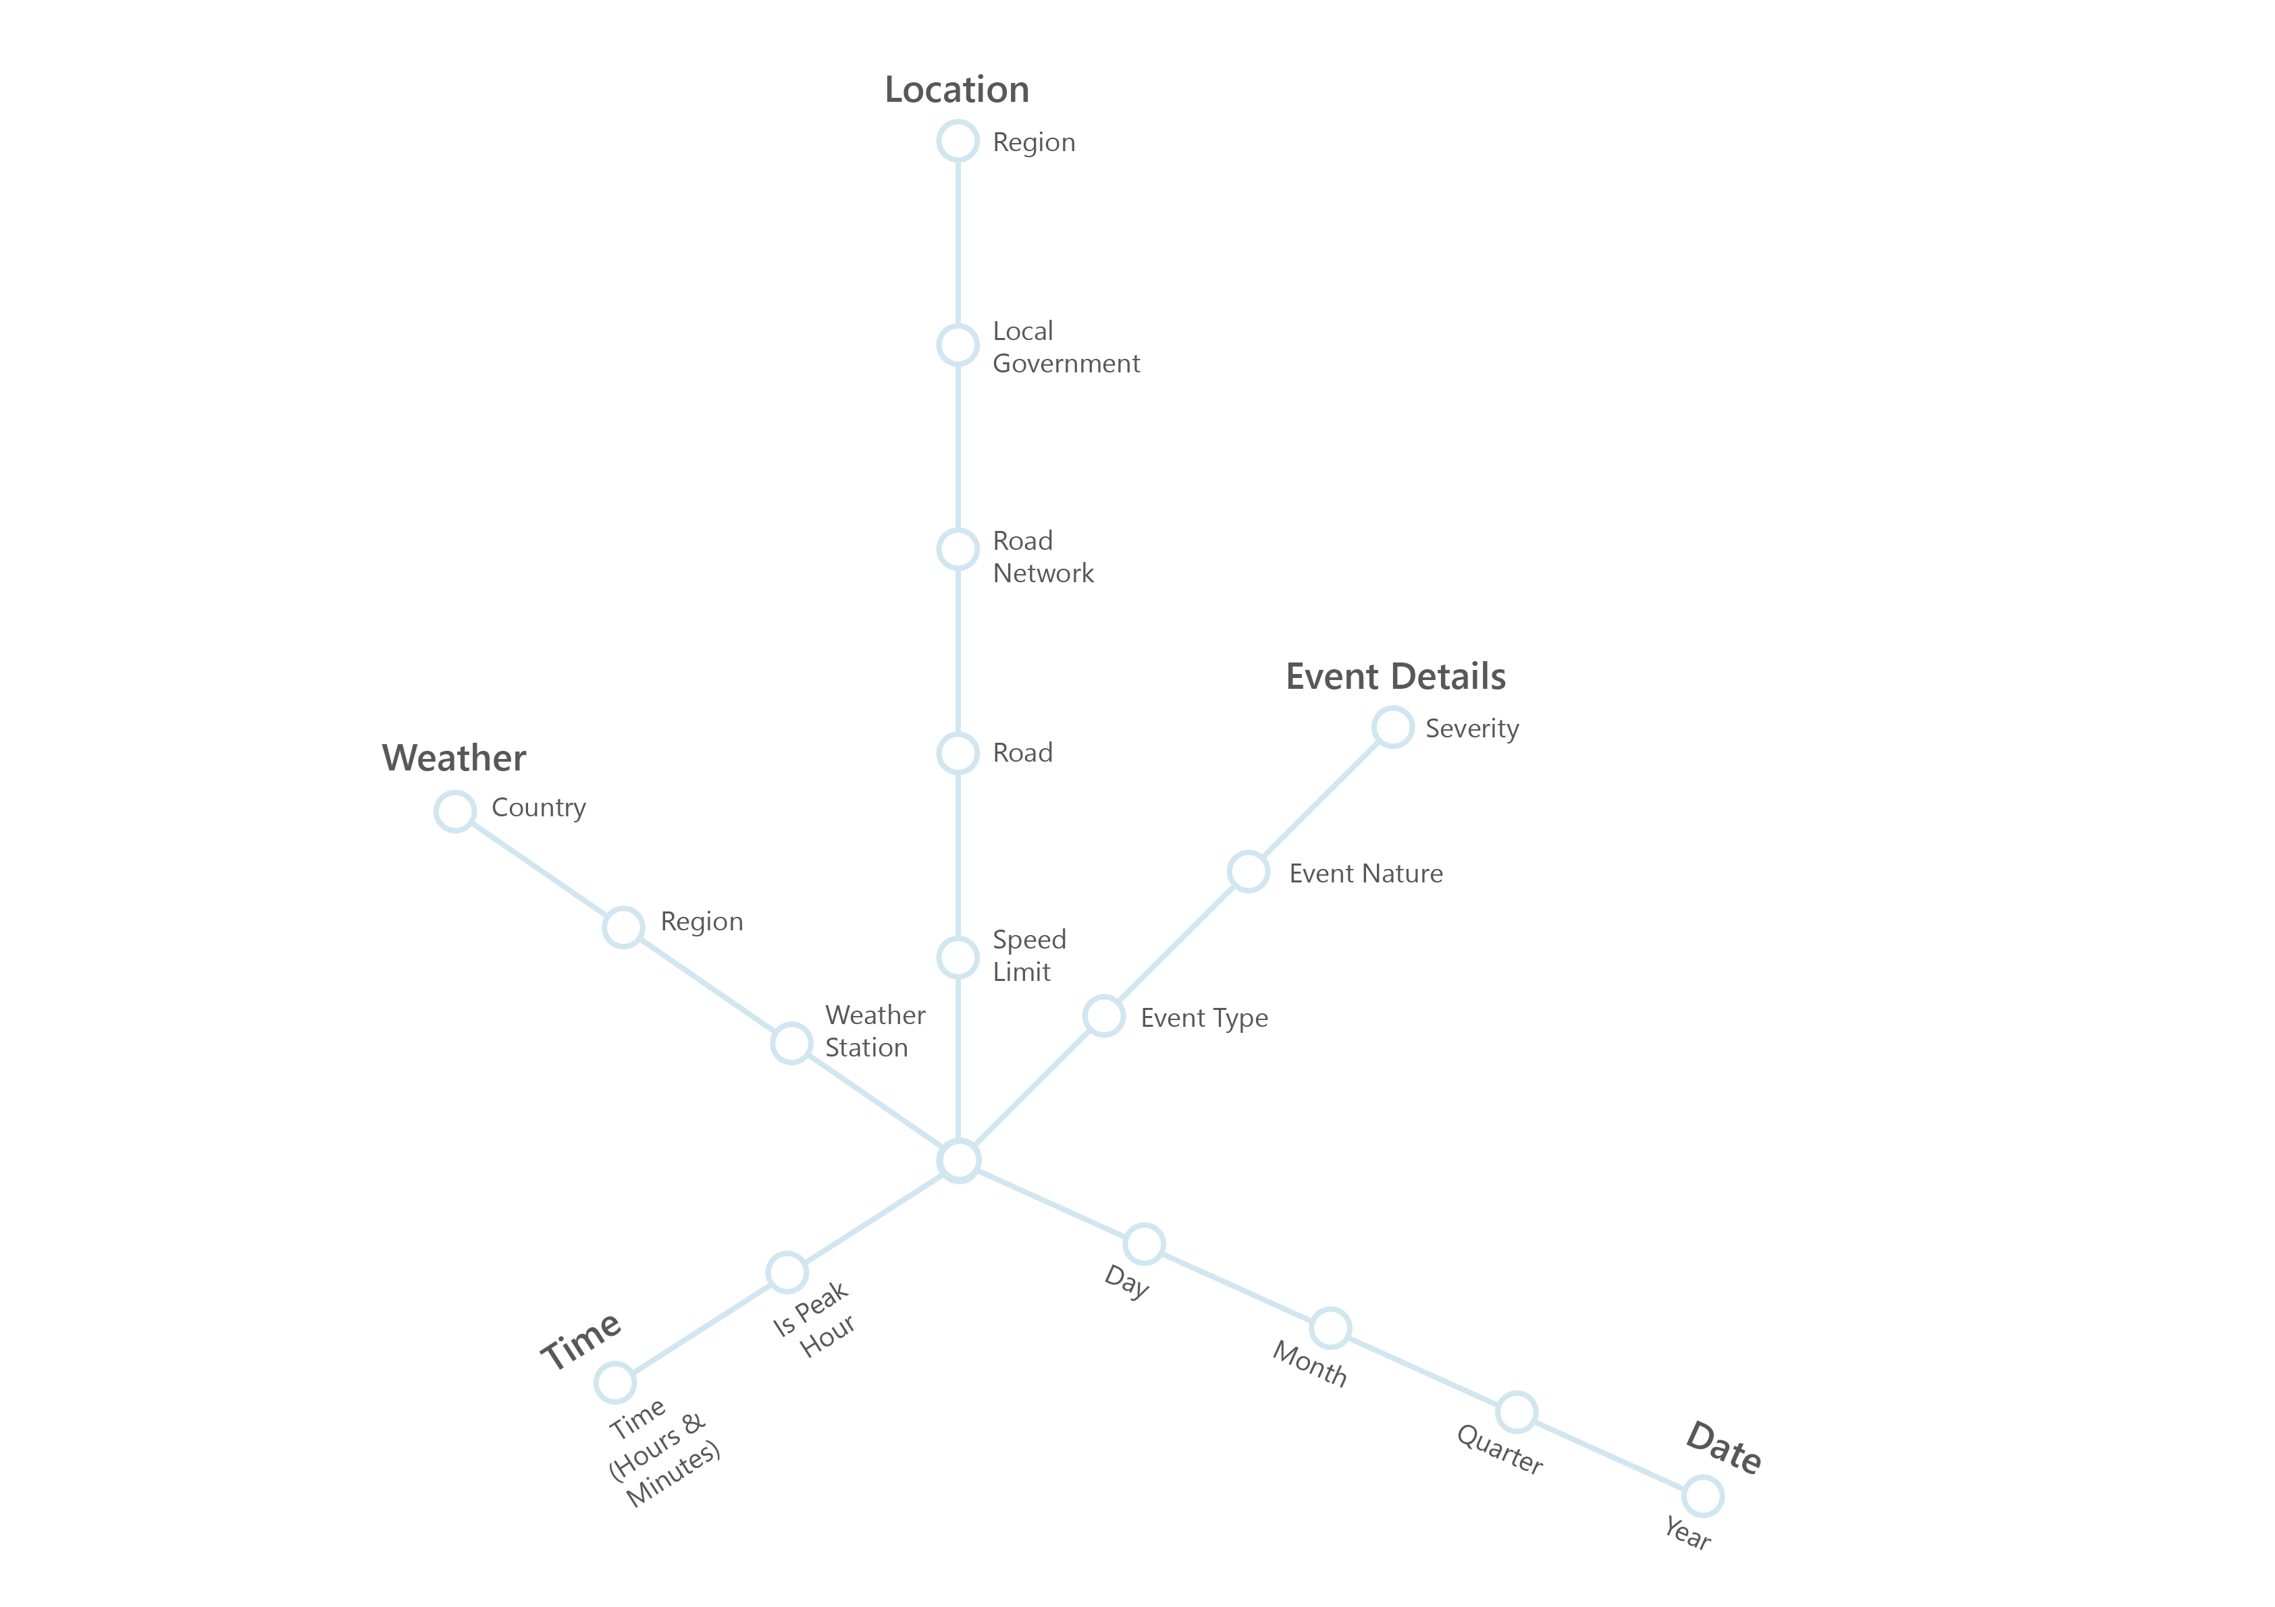
Data Warehouse | Concept Hierarchy
Notes:
David:
Our methodology was to first define the problem
We would then propose a solution to the problem and build a prototype
Collect data
Then analyze the intervention
Iterate

Slide 10
StarNet & Business Questions
Mapping Data Dimensions to Questions
CITS5504 | Data Warehousing | David Smith | 21484971
Notes:
David:
IoT Pet Pal with a focus on pet safety, owner peace of mind, and increasing the quality of life

Slide 11
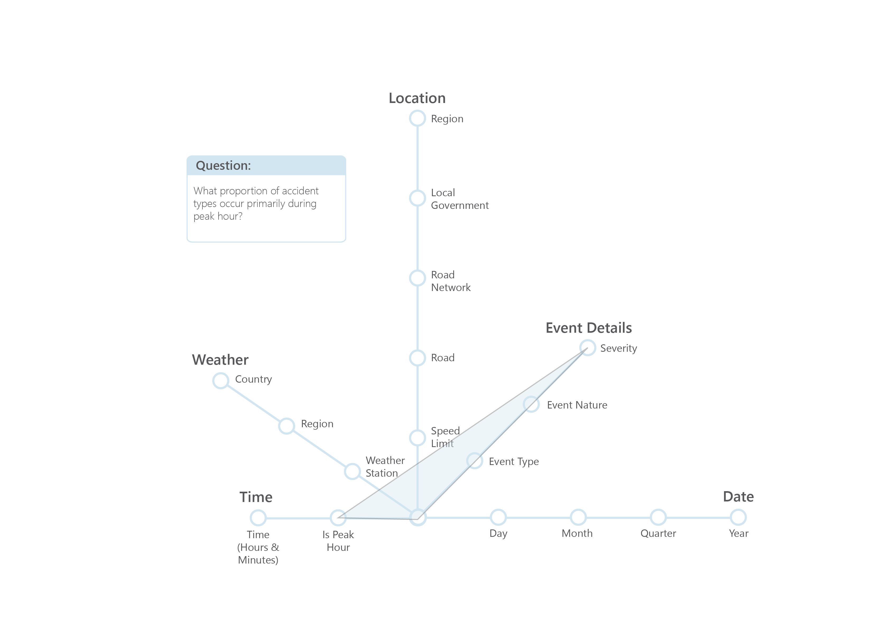
Questions | Q1
CITS5504 | Data Warehousing | David Smith | 21484971
Notes:
David:
Our methodology was to first define the problem
We would then propose a solution to the problem and build a prototype
Collect data
Then analyze the intervention
Iterate

Slide 12
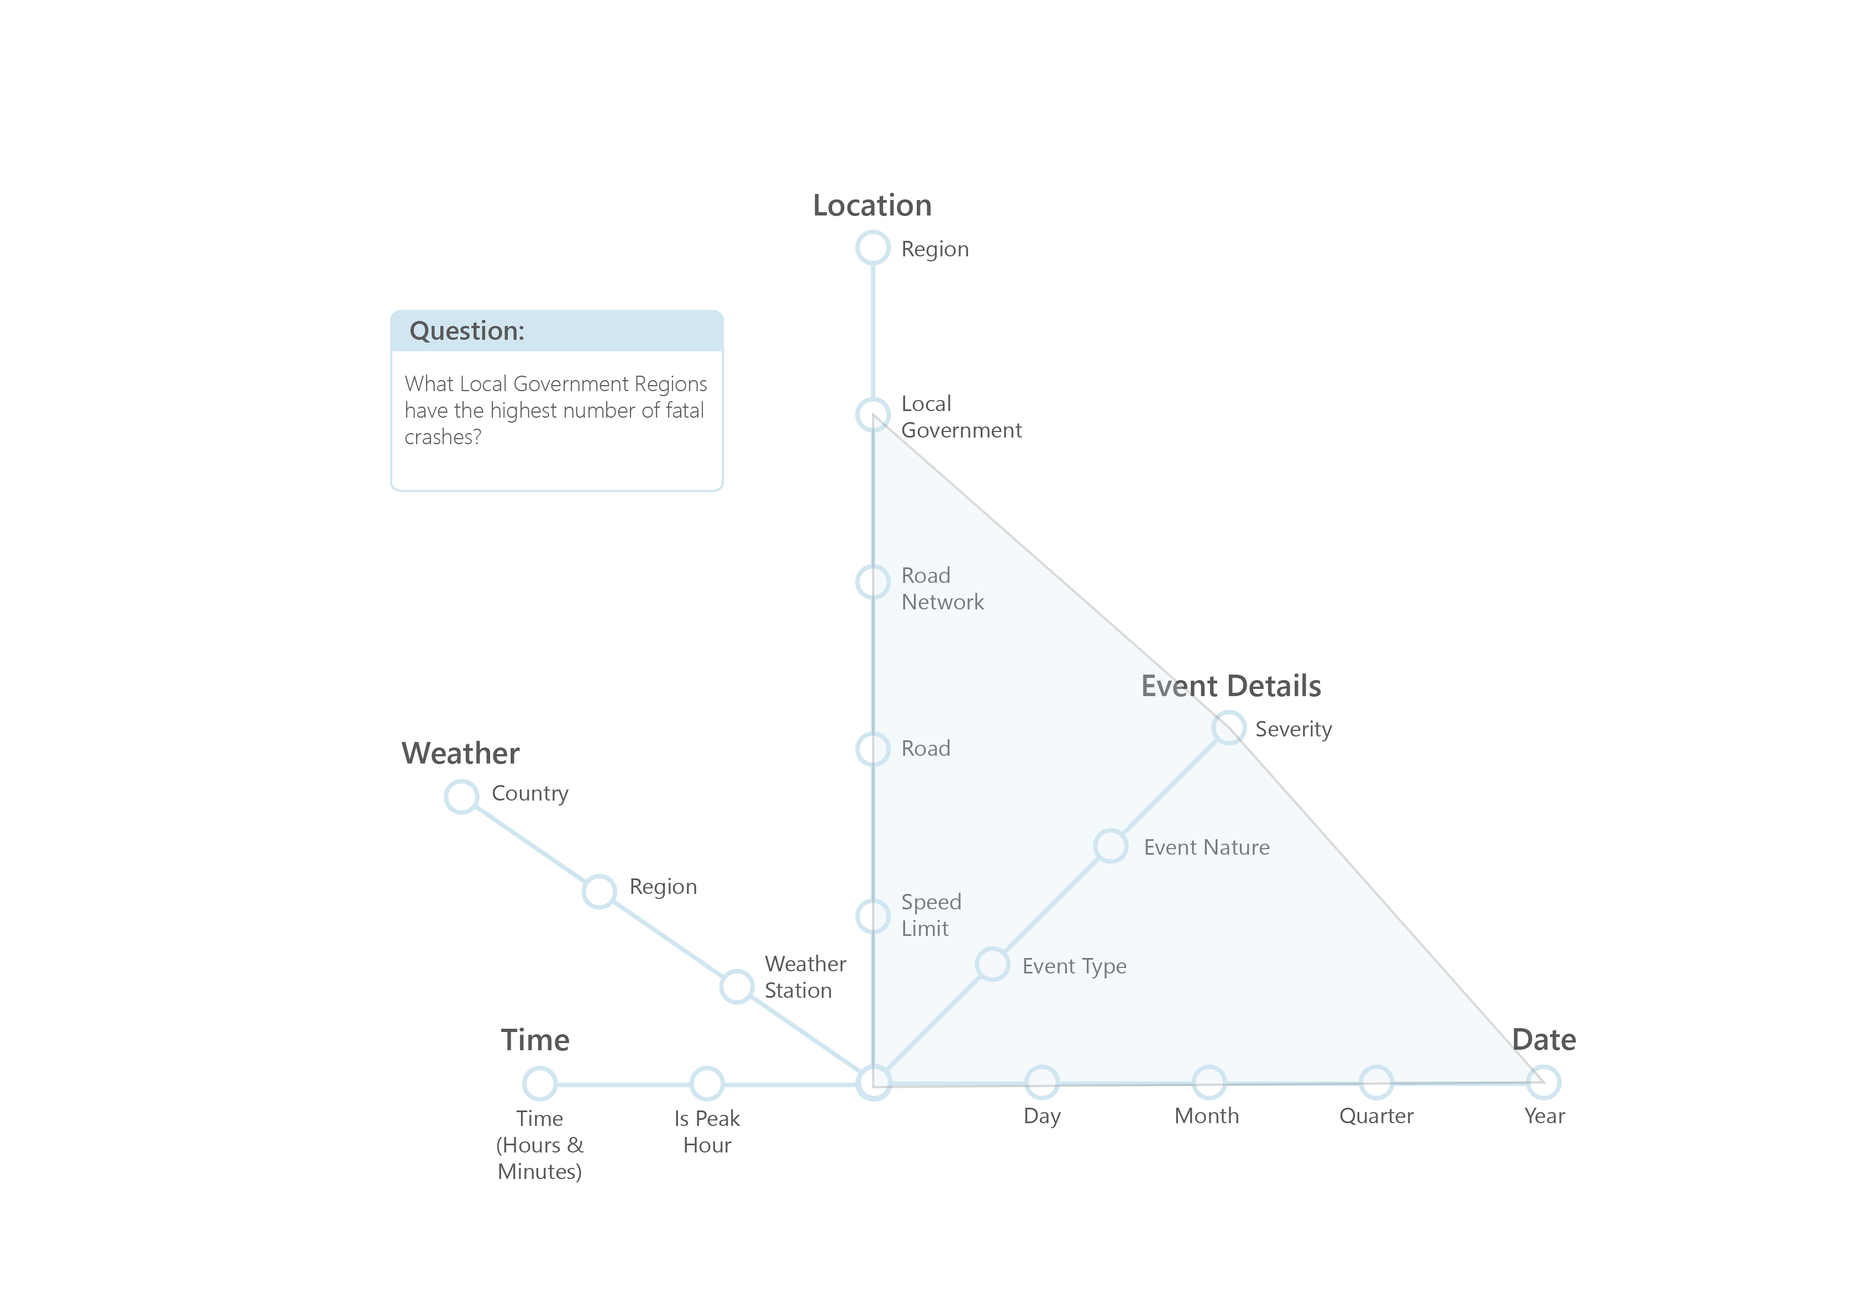
Questions | Q2
CITS5504 | Data Warehousing | David Smith | 21484971
Notes:
David:
Our methodology was to first define the problem
We would then propose a solution to the problem and build a prototype
Collect data
Then analyze the intervention
Iterate

Slide 13
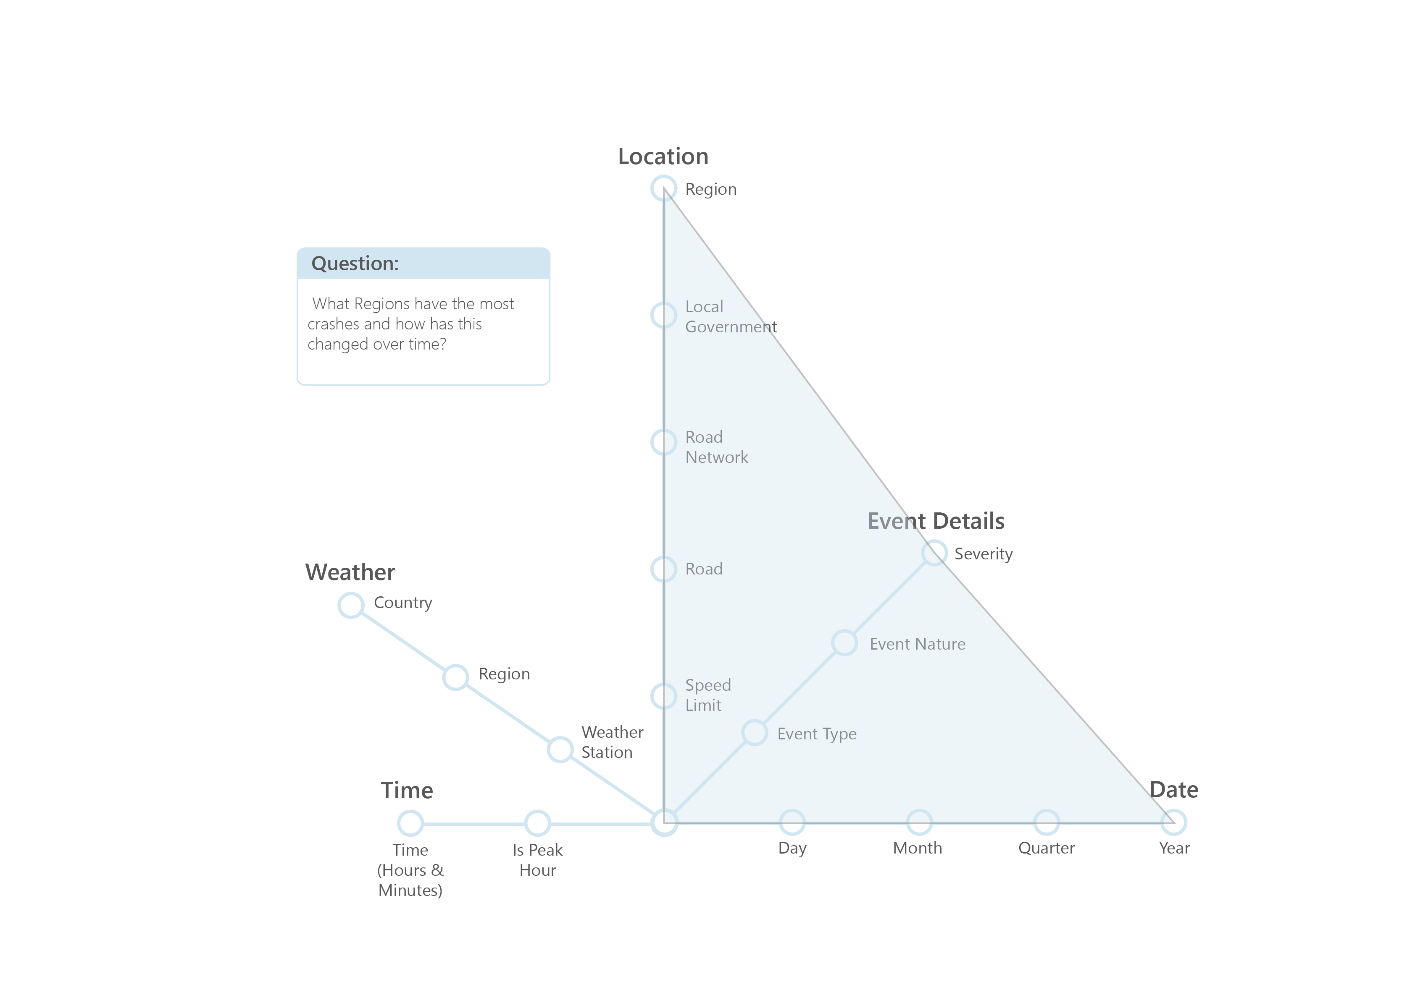
Questions | Q3
CITS5504 | Data Warehousing | David Smith | 21484971
Notes:
David:
Our methodology was to first define the problem
We would then propose a solution to the problem and build a prototype
Collect data
Then analyze the intervention
Iterate

Slide 14
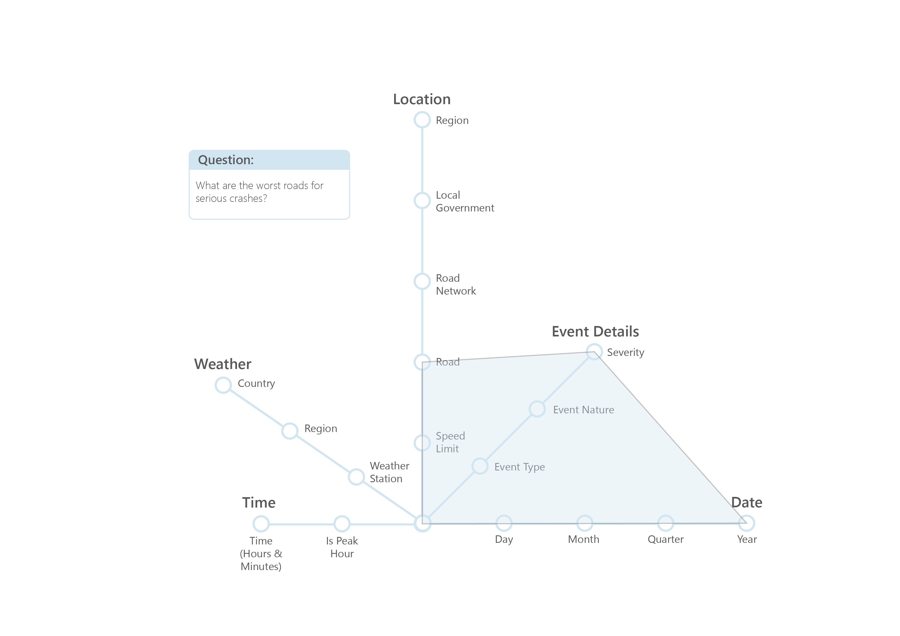
Questions | Q5
CITS5504 | Data Warehousing | David Smith | 21484971
Notes:
David:
Our methodology was to first define the problem
We would then propose a solution to the problem and build a prototype
Collect data
Then analyze the intervention
Iterate

Slide 15
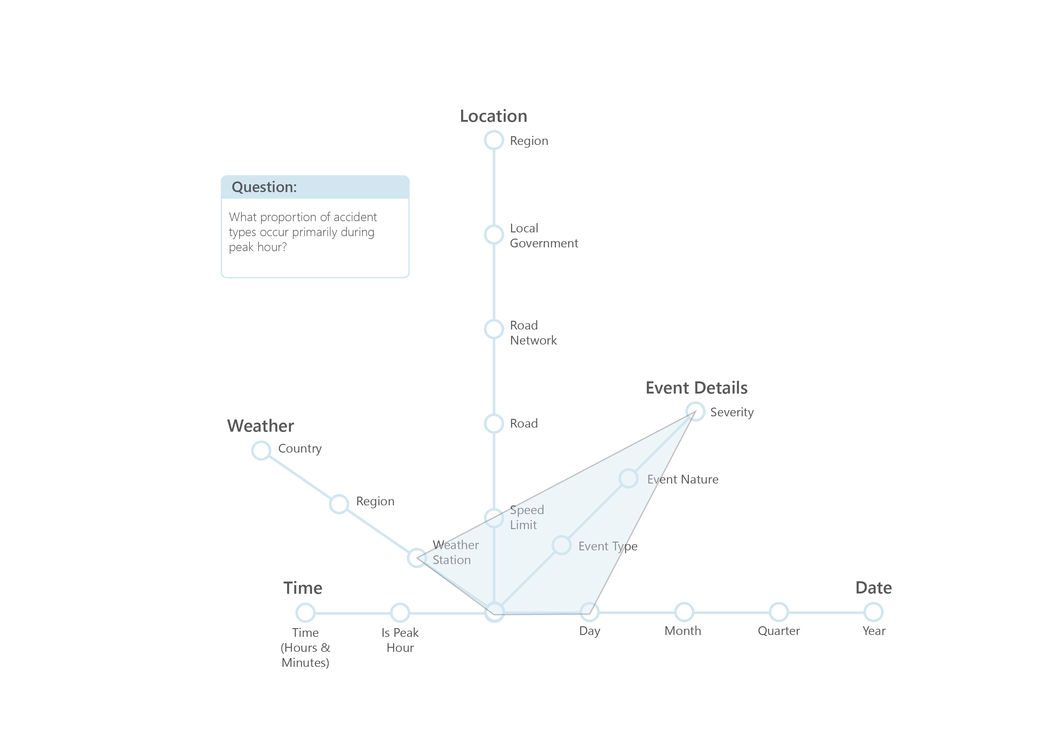
Questions | Q1
CITS5504 | Data Warehousing | David Smith | 21484971
Notes:
David:
Our methodology was to first define the problem
We would then propose a solution to the problem and build a prototype
Collect data
Then analyze the intervention
Iterate

Slide 16
Schema
Dimensions & Facts for Data Warehouse
CITS5504 | Data Warehousing | David Smith | 21484971
Notes:
David:
IoT Pet Pal with a focus on pet safety, owner peace of mind, and increasing the quality of life

Slide 17
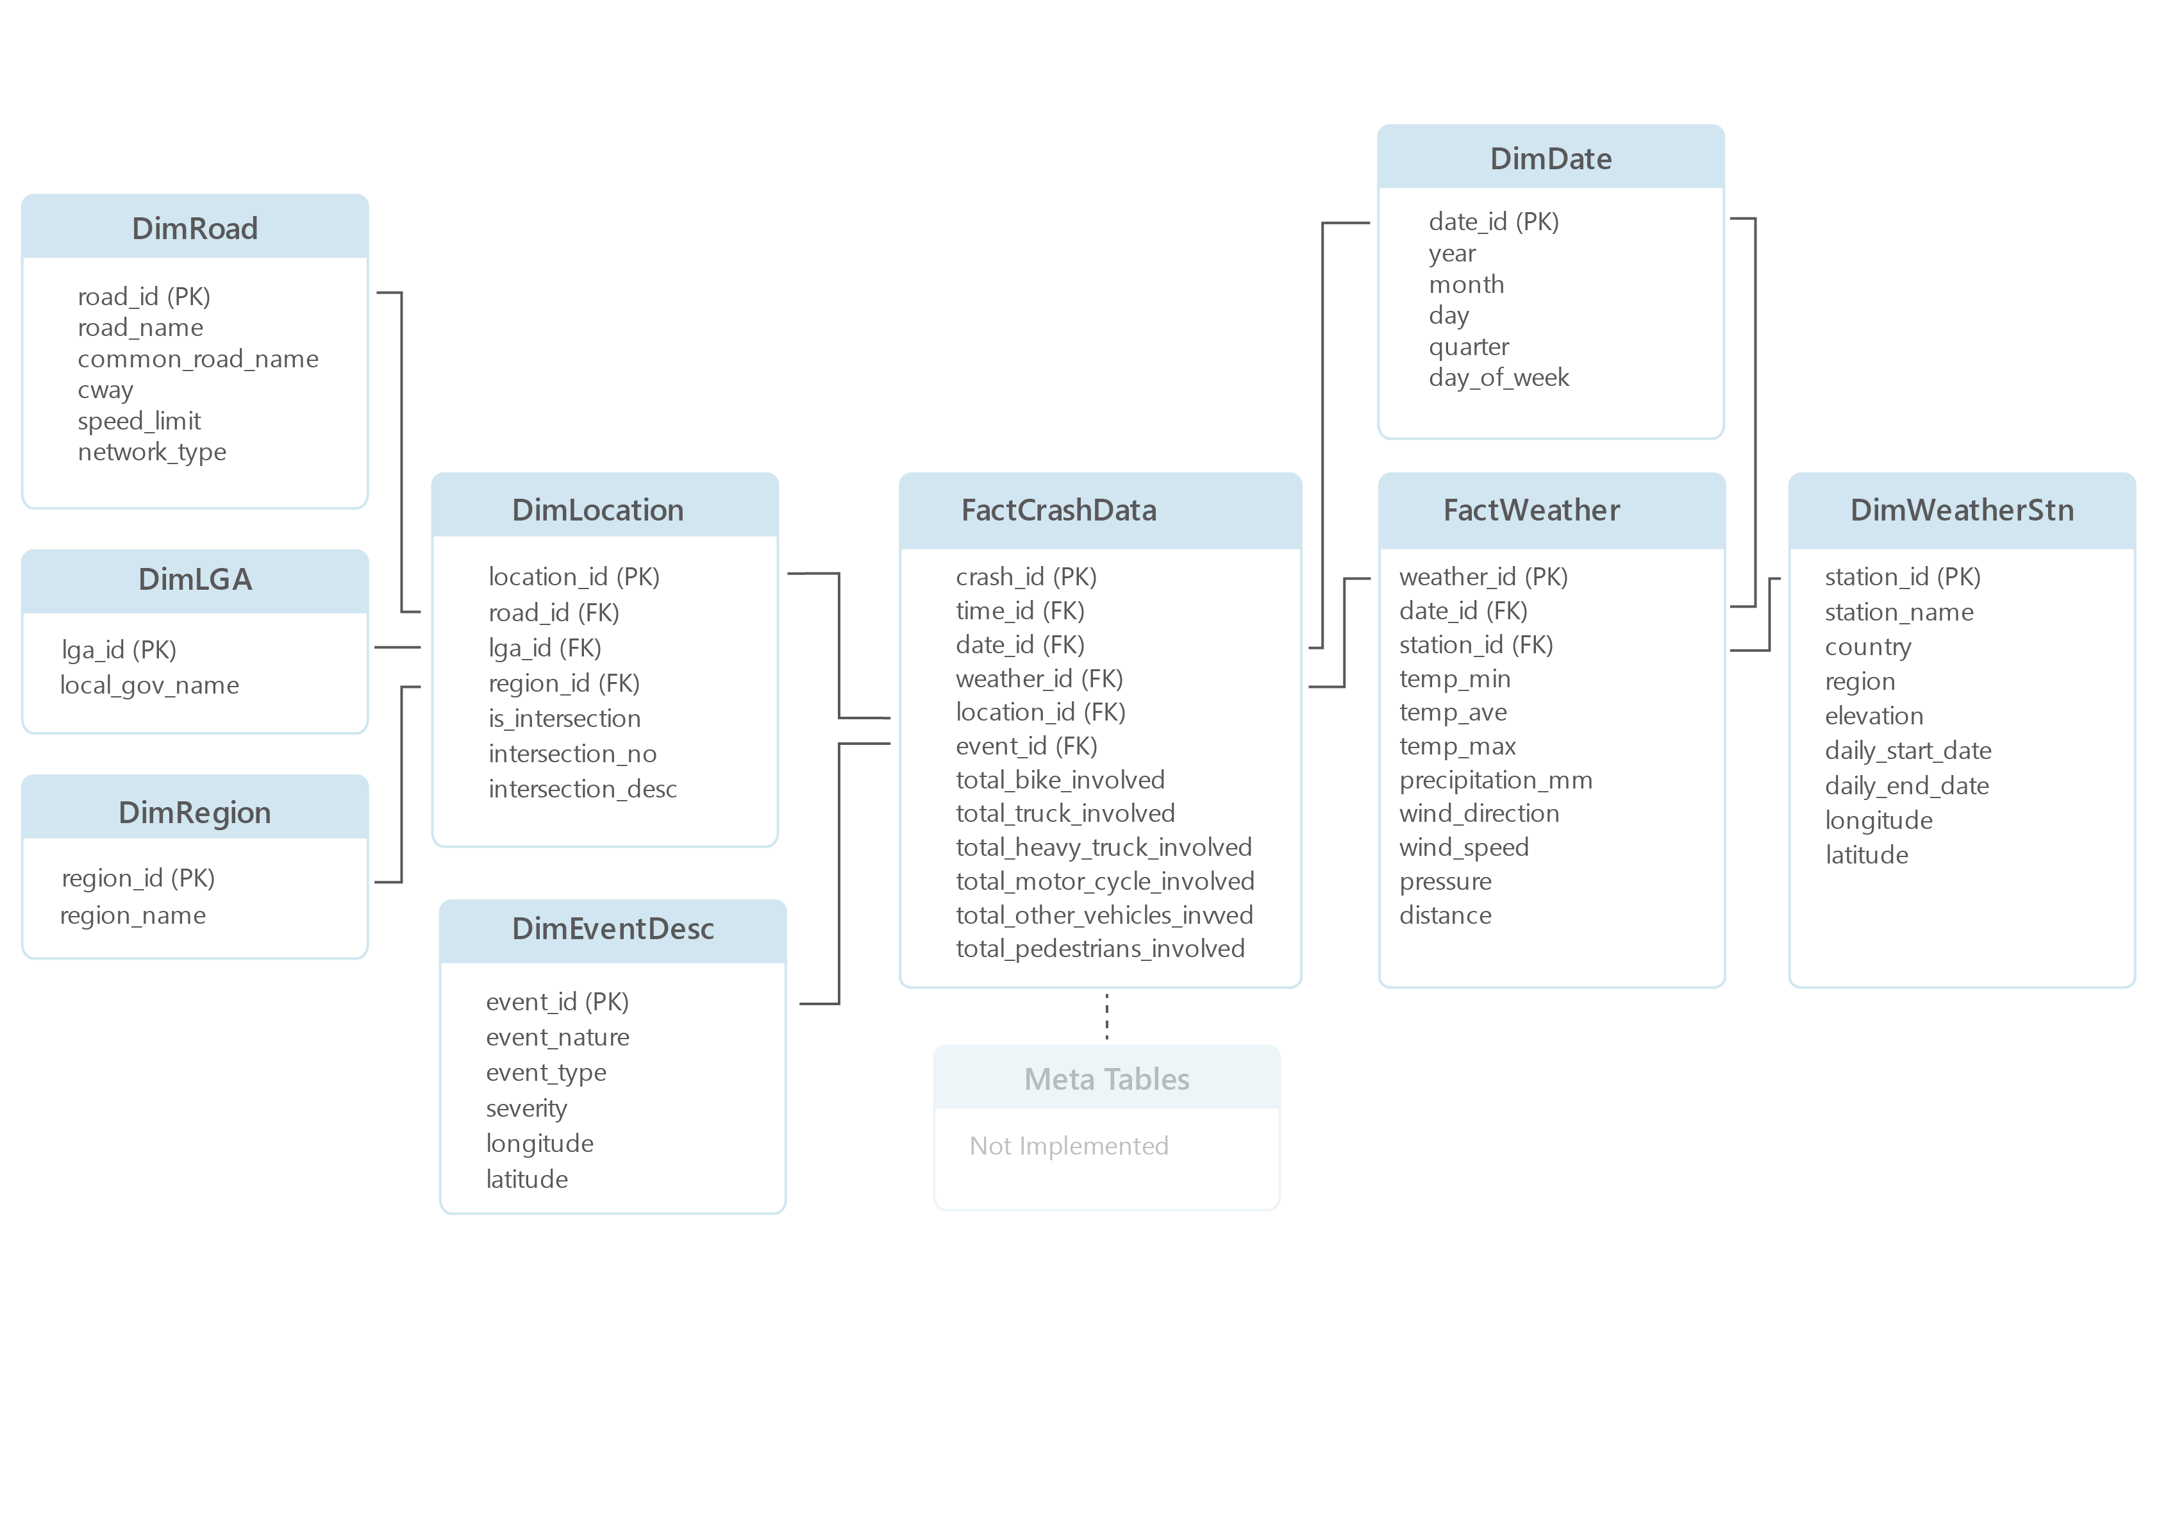
Data Warehouse | Schema & Relationships
CITS5504 | Data Warehousing | David Smith | 21484971
Notes:
David:
Our methodology was to first define the problem
We would then propose a solution to the problem and build a prototype
Collect data
Then analyze the intervention
Iterate

Slide 18
Code
SQL & Weather Snippets (See Notebook for Code)
CITS5504 | Data Warehousing | David Smith | 21484971
Notes:
David:
IoT Pet Pal with a focus on pet safety, owner peace of mind, and increasing the quality of life

Slide 19
SQL Queries | Create Table
CREATE TABLE FactCrashData (
crash_id int primary key NOT NULL,
time_id varchar(50) NOT NULL,
date_id varchar(50) NOT NULL,
weather_id varchar(50) NOT NULL,
location_id varchar(50) NOT NULL,
event_id varchar(50) NOT NULL,
total_bike_involved int NOT NULL,
total_truck_involved int NOT NULL,
total_heavy_truck_involved int NOT NULL,
total_motor_cycle_involved int NOT NULL,
total_other_vehicles_involved int NOT NULL,
total_pedestrians_involve int NOT NULL,
longitude float(24),
latitude float(24),
FOREIGN KEY (time_id) REFERENCES FactTime(time_id),
FOREIGN KEY (date_id) REFERENCES DimDate(date_id),
FOREIGN KEY (weather_id) REFERENCES FactWeather(weather_id),
FOREIGN KEY (location_id) REFERENCES DimLocation(location_id),
FOREIGN KEY (event_id) REFERENCES DimEventDesc(event_id),
);
CREATE TABLE DimDate (
date_id varchar(50) primary key NOT NULL,
year int NOT NULL,
month int NOT NULL,
day int NOT NULL,
quarter int NOT NULL,
day_of_week varchar(16) NOT NULL,
);
CREATE TABLE FactTime (
time_id varchar(50) primary key NOT NULL,
is_peak_hour BIT DEFAULT 0 NOT NULL,
);
CREATE TABLE DimWeatherStn (
station_id varchar(50) primary key NOT NULL,
station_name varchar(100) NOT NULL,
country varchar(50) NOT NULL,
region varchar(50) NOT NULL,
elevation int,
daily_start_date varchar(50),
daily_end_date varchar(50),
longitude float(24),
latitude float(24),
);
CREATE TABLE FactWeather (
weather_id varchar(50) primary key NOT NULL,
date_id varchar(50) NOT NULL,
station_id varchar(50) NOT NULL,
temp_min float,
temp_ave float,
temp_max float,
precipitation_mm float,
wind_direction float,
wind_speed float,
pressure float,
distance int,
FOREIGN KEY (date_id) REFERENCES DimDate(date_id),
FOREIGN KEY (station_id) REFERENCES DimWeatherStn(station_id),
);
CREATE TABLE DimRoad (
road_id varchar(50) primary key NOT NULL,
road_name varchar(500) NOT NULL,
common_road_name varchar(500),
cway varchar(50),
speed_limit varchar(100),
network_type varchar(50),
);
CREATE TABLE DimLocation (
location_id varchar(50) primary key NOT NULL,
road_id varchar(50) NOT NULL,
lga_id varchar(50) NOT NULL,
region_id varchar(50) NOT NULL,
is_intersection BIT DEFAULT 0 NOT NULL,
intersection_no int,
intersection_desc varchar(500),
FOREIGN KEY (road_id) REFERENCES DimRoad(road_id),
FOREIGN KEY (lga_id) REFERENCES DimLGA(lga_id),
FOREIGN KEY (region_id) REFERENCES DimRegion(region_id),
);
CREATE TABLE DimLGA (
lga_id varchar(50) primary key NOT NULL,
local_gov_name varchar(100) NOT NULL,
);
CREATE TABLE DimRegion (
region_id varchar(50) primary key NOT NULL,
region_name varchar(100) NOT NULL,
);
CREATE TABLE DimEventDesc (
event_id varchar(50) primary key NOT NULL,
event_nature varchar(50),
event_type varchar(50),
severity varchar(50),
);
Notes:
David:
Our methodology was to first define the problem
We would then propose a solution to the problem and build a prototype
Collect data
Then analyze the intervention
Iterate

Slide 20
SQL Queries | Load Data
def create_sql_insert_string():
print("create_sql_insert_string not implemented")
def export_sql_insert_query(table_name , query_string):
with open("./sql_queries/Insert_Data_{0}.sql".format(table_name), "w") as text_file:
print(query_string, file=text_file)
def insert_data_query_builder(table_name: str , df: pd.DataFrame , connection):
df = df.fillna("NULL")
columns = " , ".join([column for column in df.columns])
out_strings = []
for records in df.to_records(index=False):
values = str(records)
values = str(records).replace("'NULL'" , "NULL")
query = "INSERT INTO {0} ({1}) VALUES {2}".format(table_name , columns , values )
out_string = insert_data(connection , query , table_name )
if out_string != None:
out_strings.append(out_string)
if len(out_strings) > 0 :
print("\n".join(out_strings[:5]))
def insert_data(connection , insert_string , table_name ):
## insert values into database
cursor = connection.cursor()
try:
# Insert Dataframe into SQL Server:
cursor.execute(insert_string)
# print("inserted data to {0} Table".format(table_name))
connection.commit()
cursor.close()
return None
except Exception as e:
connection.commit()
cursor.close()
return"Insert Failed: {0} | {1}".format(table_name , e)
def insert_dim_values(connection, table_name:str , df: pd.DataFrame , table_data ):
print("----------- {0} ----------".format(table_name))
## Filter dataframe to only values
df = df[[input[0] for input in table_data if str(input[0]).find("FOREIGN KEY") == -1]]
## Remove Duplicates
df.drop_duplicates(inplace=True , subset=table_data[0][0])
df.to_csv("./csv/{0}.csv".format(table_name))
insert_data_query_builder(table_name , df , connection)
def insert_fact_values(connection, table_name:str , df: pd.DataFrame , table_data ):
print("----------- {0} ----------".format(table_name))
## Filter dataframe to only values
df = df[[input[0] for input in table_data if str(input[0]).find("FOREIGN KEY") == -1]]
df.to_csv("./csv/{0}.csv".format(table_name))
insert_data_query_builder(table_name , df , connection)
############### EXAMPLE Create Table & INSERT ###############
## Date Dimension
table_data = [
["date_id", "varchar(50) primary key", "NOT NULL"],
["year", "int", "NOT NULL"],
["month", "int", "NOT NULL"],
["day", "int", "NOT NULL"],
["quarter", "int", "NOT NULL"],
["day_of_week", "varchar(16)", "NOT NULL"],
# ["is_holiday", "BIT DEFAULT 0", "NOT NULL"],
]
create_table_function(conn, "DimDate", table_data)
insert_dim_values(conn, "DimDate" , merged_df , table_data )
Notes:
David:
Our methodology was to first define the problem
We would then propose a solution to the problem and build a prototype
Collect data
Then analyze the intervention
Iterate

Slide 21
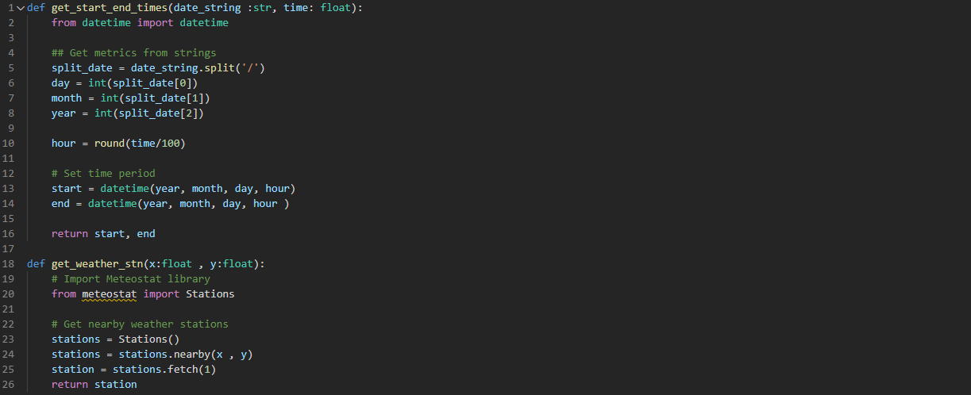
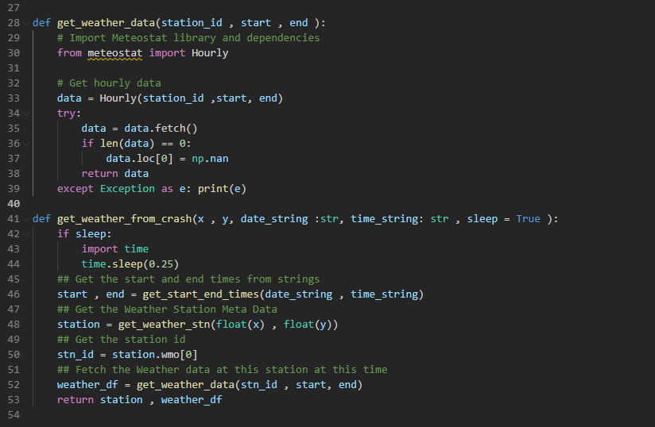
Weather Data | Meteostat & Code
Notes:
David:
Through this process we realized the vast differences in the animals and how they require different interactions
For example Jimmy pined at the door when family left him and only barked at other dogs

